Slide 1
DevOps
Workshop

Slide 2
Module 4
Objectives
The team evolution
Describe phases of team work
Survival, Learning, Self-Organization
How to use Theory of Constraints to evolve your system
Netflix and Chaos Monkey
One thing more…
12 factor apps
Containers and Docker
The Third Way and how experimenting and taking risks can take us to greatness.
Notes:
Presentations: http://www.slideshare.net/quaip/docker-sysmana-2014
Book: The Docker Book: http://www.dockerbook.com

Slide 3
Evolve

Slide 4
Team evolution
Notes:
Vanguard Method: https://vanguard-method.net/the-vanguard-method-and-systems-thinking/

Slide 5
Evolve
The next step is to experiment, learn and evolve. Think on what’s need to change, how the world should be and plan a travel to there.
At some point, you can find your IT team need to change, but how to do it?

Slide 6
Evolve
Team
Identify the phase your IT team is in:
Survival
Learning
Self organization
Use the following criteria:
Do you have time to learn?
Do you disconnect mobile on holidays?
Do you feel your team can grow without management?

Slide 7
Survival Phase
Comfortable zone
Some type of addiction
Command and control leadership
How to get out? Create slack time and use it to learn.
Visualize your work (KANBAN)
Establish commitments
Prevent workload
Plan a deadline to have learning time
“No time to learn”

Slide 8
Learning Phase
Learning implies time
slow curve of apprentice
productivity ravines
Learn commitment language
“I will [action] By [certain date]”
Only things under your control
Turn things into “under control”
Not: I will solve this with David by today
Better: I will invite David to a meeting by today to solve this
Use OKR’s
“Challenging the team to grow”
Notes:
Turn things into under control
Not I will fix these 5 issues by the end of this week, but I will work at least 5 hours each day this week to solve this issues.
Not I will solve this with David, but I will invite David to a meeting today about solving this

Slide 9
Self Organization Phase
When everyone learns how to solve their own problems.
Clearing meetings (Retrospectives)
What has not been working for you?
What are you going to do about it?
What has been working for you?
“To advance toward the ability and skills to solve problems without management.”

Slide 10
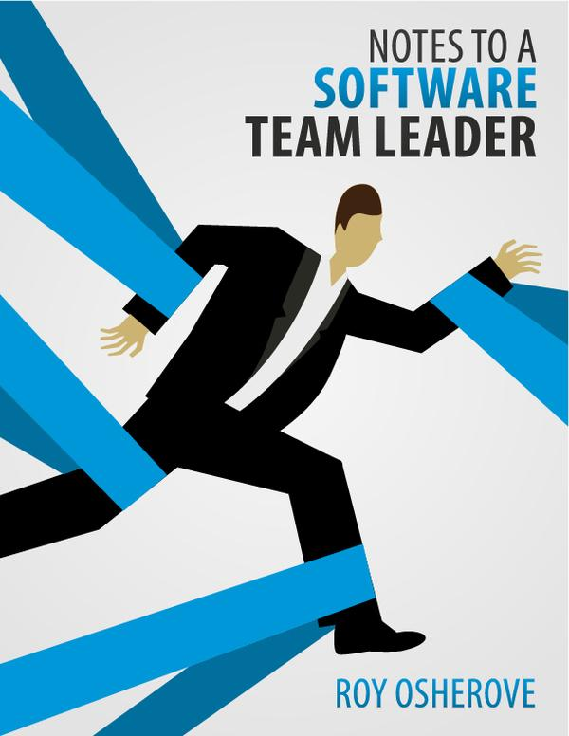
Evolve
Team
Recommendation
Read this book.
Get your boss read this book.
Improve by challenging your team (OKR’s)

Slide 11
Systems Thinking
Notes:
Vanguard Method: https://vanguard-method.net/the-vanguard-method-and-systems-thinking/

Slide 12
Evolve
Systems Thinking
Objective: “Deploy 10 times per day”
10 deploys per day means how much should the system change to flow this and much more (i.e: 100/1000 deploys per day)

Slide 13
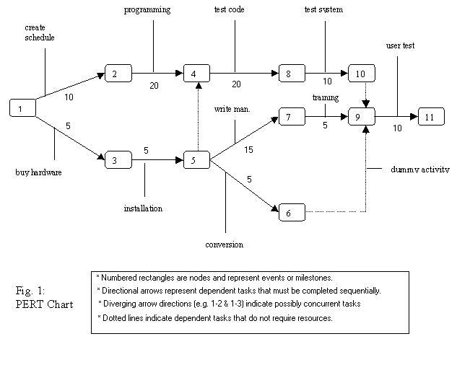
Evolve
Know your deployment process
Trace a line from development to production and add every step involved in the process to publish a release.
This is your pipeline.
Add estimations of how much it takes to process a unit in that step.
At the end you should have a graph like this (PERT graph):

Slide 14
Evolve
Observe your system
Establish metrics and measure the performance along the process. How much time does it takes to go from step one to step two? What are the global times?
We are not talking about CPU performance nor Network bandwidth, but how many times you can do something per unit time. How many business objects are created per unit time. What is the bandwidth (flow) of your deployment chain?
Answer these questions: What are the maximums? Where are the limits?

Slide 15
Evolve
Step 1: Identify the constraints
When you see how you deploy and how much effort it costs, it is easy to identify where the process get stuck.
Maybe you will see several bottlenecks, but focus on the most blocking knot of the process.
Now, add stress to the system considering 10 deploys per time unit. Will your system support it?

Slide 16
Evolve
Focus on one bottleneck
The most difficult part of the process is to define only one bottleneck to break.
You will be tempted to select several. That is the usual error.
Why only one?
Because we are doing improvement in small steps, so we need to concentrate at the beginning.

Slide 17
Evolve
Step 2: Decide how to exploit the bottleneck
In the process to increase your ability to deploy (Global Optimization), you need to take decisions. The first one is to break the bottleneck by modifying your process so it would give you more throughput at the end of the process, not only on that point.

Slide 18
Evolve
Step 3: Subordinate everything else to the decisions
This is when DevOps begins
Your solutions must be considered like features, same than development. It is not a “Operations task”. It is for everyone. We all are on IT.
Include them inside the planning, visualize them inside the kanban or the roadmap. Assign dev and ops resources to work together on this.

Slide 19
Evolve
Step 4: Elevate the performance.
Verify you are working on the right track by measuring performance. Publish reports and take them to retrospectives.
Discuss if you have elevate the constraint. If so, go to the next step.
If not, rethink again.

Slide 20
Evolve
Step 5: If the constraint has shifted, back to Step 1
The process never ends.
You are improving a production chain.
Accidents and issues happens all the time.
It is an unbalanced system.

Slide 21
Evolve
Building the deploy tool chain using constraints
First of all, listen to the people. They complain all the time, so you will get good feedback about which thing to do first.
Then, challenge them to solve their complains. Help them to grown, not to solve their problems.
Remember: small steps, one thing per iteration, fast paced, great improvement.

Slide 22
Evolve
Building the deploy tool chain using constraints
Constraint | Solution | Tool/s
Insufficient Infrastructure | Use virtualization to optimize hardware performance. Use cloud to expand your limits (it is all OPEX) | VMware, Virtualbox, vagrant, docker… AWS, Google Cloud Platform,...
Environments are not similar | Use configuration management systems to set development environments as similar as production | Chef, Puppet, Ansible, Salt...
Cooperation tools | Use Instant messaging and team sharing tools to increase communication | JIRA, redmine, slack, hangouts
Build Tools | Automated tools that keep modules versioned and shippables | Maven,Gradle,Nexus, Artifactory, Aptly,

Slide 23
Evolve
Building the deploy tool chain using constraints
Constraint | Solution | Tool/s
Logs are difficult to use | Collect logs centrally, use tools to visualize trends and exceptions. | Elasticsearch, Logstash, Kibana, Logtrust, Logentries
Source code not distributable | Use distributed version control systems | git, mercurial Github, bitbucket
Process is too difficult to execute | Use automation tools to write one, execute many (and use only a button) | Jenkins, Go, Codeship, ClinkerHQ, Cloudbees
Testing is difficult and slow | Create different types of tests: unit test, integration test, acceptance test. Distribute them between phases and automate them | Junit, JBehave, Rspec, Cucumber, Selenium, SmartBear

Slide 24
Experiment

Slide 25
Netflix and Chaos Monkey

Slide 26
Netflix and Chaos Monkey
http://techblog.netflix.com/2012/07/chaos-monkey-released-into-wild.html
How an outage developed a more resilience network. Take this story as a point of departure to evolve your systems and enforce your systems thinking.
Think: what if a service in your network suddenly stops responding?

Slide 27
12 Factor Applications

Slide 28
12 Factor Applications
Reference: http://12factor.net
It is a methodology to build software-as-a-service applications that:
Use declarative formats for setup automation, to minimize time and cost for new developers joining the project;
Have a clean contract with the underlying operating system, offering maximum portability between execution environments;
Are suitable for deployment on modern cloud platforms, obviating the need for servers and systems administration;
Minimize divergence between development and production, enabling continuous deployment for maximum agility;
And can scale up without significant changes to tooling, architecture, or development practices.

Slide 29
12 Factor Applications
I. Codebase: One codebase tracked in revision control, many deploys
II. Dependencies: Explicitly declare and isolate dependencies
III. Config: Store config in the environment
IV. Backing services: Treat backing services as attached resources
V. Build, release, run: Strictly separate build and run stages
VI. Processes: Execute the app as one or more stateless processes
VII. Port binding: Export services via port binding

Slide 30
12 Factor applications
VIII. Concurrency: Scale out via the process model
IX. Disposability: Maximize robustness with fast startup and graceful shutdown
X. Dev/prod parity: Keep development, staging, and production as similar as possible
XI. Logs: Treat logs as event streams
XII. Admin processes: Run admin/management tasks as one-off processes

Slide 31
Docker

Slide 32
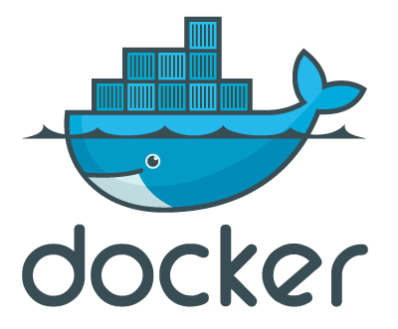
http://www.slideshare.net/dotCloud/docker-intro-november

Slide 33
Docker
Docker is an open-source engine that automates the deployment of any application as a lightweight, portable, self-sufficient container that will run virtually anywhere.
Un contenedor es una imagen (directorio) de una distro de linux más una gestión de recursos (cpu, memoria, volumes) asociada.
Docker: es “casi” una máquina virtual orientada a aplicaciones y versionada.

Slide 34
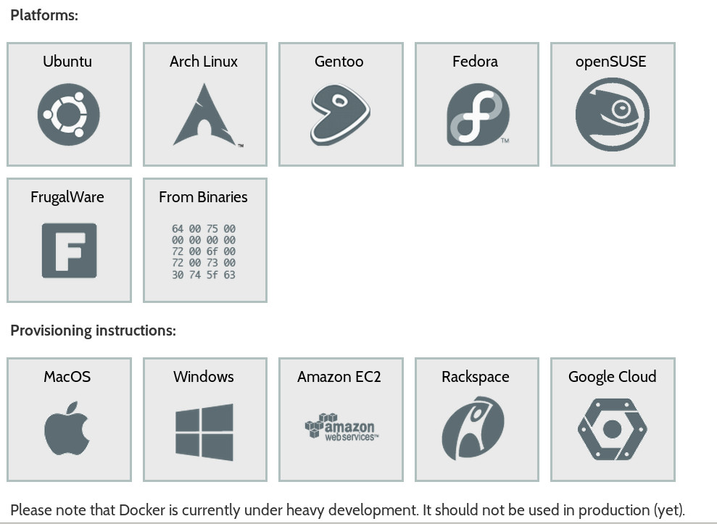
Docker
Se instala:
por paquetería estándar
máquina virtual ubuntu
Se maneja:
por comandos
por orchestradores
kubernetes
tutum
aws ecs

Slide 35
Docker
Dockerfile
Es el fichero de instrucciones que hay que ejecutar para montar una imagen para futuros contenedores.
Se puede usar como sistema de construcción de aplicaciones.
Puedes descargar uno hecho o escribirlo tú.

Slide 36
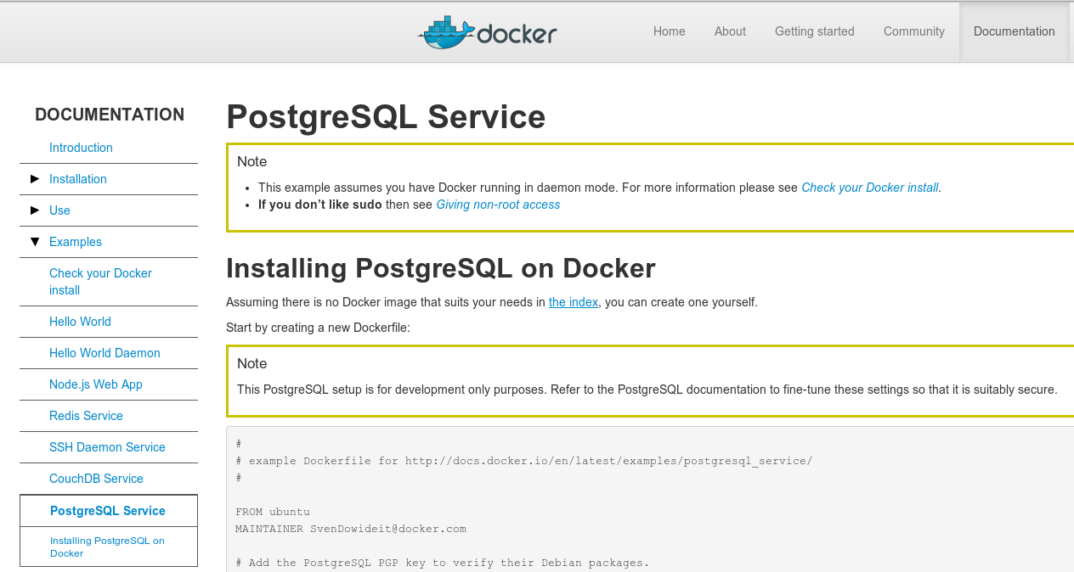
Docker
Dockerfile y PostgreSQL
http://docs.docker.com/en/latest/examples/postgresql_service/

Slide 37
Docker
Qué hace el Dockerfile?
Se descarga una imagen de ubuntu
Configura los repositorios
Descarga los paquetes
Configura pg_hba para acceso remoto
Configura postgresql.conf para acceso remoto
Crea un usuario de base de datos llamado docker
Cuando se ejecuta, arranca la base de datos y abre el puerto

Slide 38
Docker
FROM ubuntu:latest
RUN apt-key adv --keyserver hkp://keyserver.ubuntu.com:80 --recv ACCC4CF8
RUN echo 'deb http://apt.postgresql.org/pub/repos/apt precise-pgdg main 9.3' | tee /etc/apt/sources.list.d/postgresql.list
RUN apt-get update
RUN apt-get -y install postgresql-9.3 postgresql-client-9.3 postgresql-contrib-9.3
RUN echo "host all all 0.0.0.0/0 md5" >> /etc/postgresql/9.3/main/pg_hba.conf
RUN echo "listen_addresses='*'" >> /etc/postgresql/9.3/main/postgresql.conf
RUN sed -i -e "/^ssl.*$/d" /etc/postgresql/9.3/main/postgresql.conf
VOLUME ["/etc/postgresql","/var/log/postgresql","/var/lib/postgresql"]
USER postgres
RUN /etc/init.d/postgresql start &&\
psql --command "CREATE USER docker WITH SUPERUSER PASSWORD 'docker';" &&\
createdb -O docker docker
EXPOSE 5432
CMD ["/usr/lib/postgresql/9.3/bin/postgres --config-file=/etc/postgresql/9.3/main/postgresql.conf"]

Slide 39
Docker
Construir una nueva imagen
$ sudo docker build -t pg93-1 - < Dockerfile
….. y empieza la magia …..

Slide 40
Docker
Crear un contenedor
$ sudo docker run -rm -i -t pg93-1 &
Se arranca una máquina y el puerto 5432 aparece expuesto al host.

Slide 41
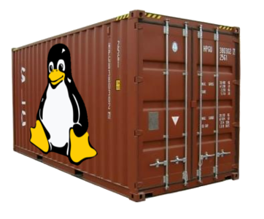

Docker
Se pueden crear varios containers a la vez, ya que cada instancia del contenedor tiene una IP diferente.
Esto permite montar arquitecturas de prueba para montar replicaciones.

Slide 42
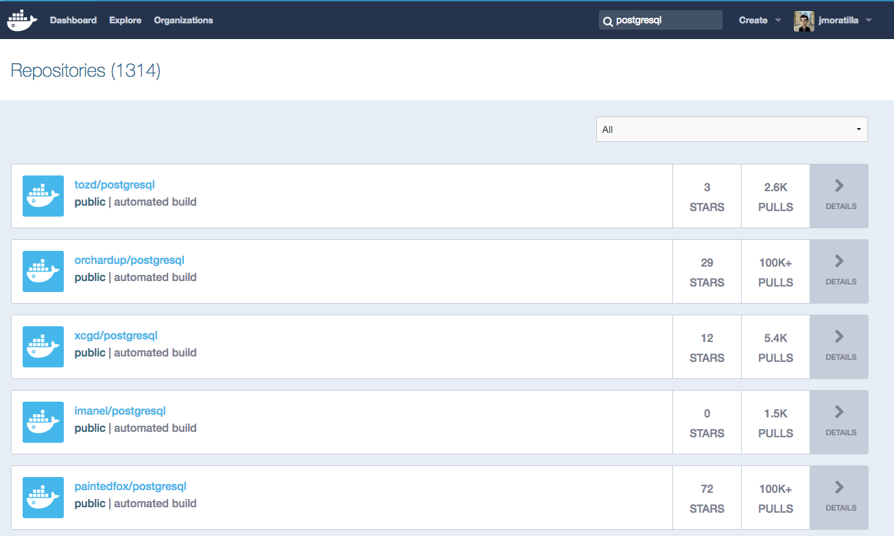
Docker
hub.docker.com
Es un repositorio de imágenes precreadas de docker.
Buscas lo que necesitas
y lo descargas.

Slide 43
Docker
docker-compose
Utilidad de docker para combinar imágenes de docker con tu desarrollo.
pg93:
image: postgres:9.3
ports:
- "5432:5432"
pg94:
image: postgres:9.4
ports:
“5433:5432”
web:
build: .
ports:
- "8080:5000"
volumes:
- .:/code
links:
- db
environment:
- DATABASE_URL=postgres://pg93/postgres
PG-9.3
web
PG-9.4

Slide 44
Docker
Y aún hay más...
docker swarm: cluster de hosts para docker
kubernetes: solución de google para docker
PaaS de andar por casa:
dokku (http://dokku.viewdocs.io/dokku/)
deis (http://deis.io/)
… pero eso ya es otra historia.

Slide 45
Microservices

Slide 46
Microservices
Check any of the following presentations:
http://es.slideshare.net/AmazonWebServices/arc309-getting-to-microservices-cloud-architecture-patterns
http://es.slideshare.net/IzzetMustafaiev/microservices-architecture
Notes:
http://www.slideshare.net/danilop/microservice-architecture-on-aws-using-aws-lambda-and-docker-containers
https://www.infoq.com/presentations/lessons-migration-legacy-microservices

Slide 47
Summary Module 4
Do we have a good understanding about?
What DevOps means for business and teams
How to identify the phases of the teams
How to use Theory of Constraints and Conflict Cloud to go further
How Docker works and its value for a business
Microservices
Third Way and how the team evolve

Slide 48
Lab 4
Objectives:
We are going to use our environment and transform some services to docker. We are going to play with Bluemix, Heroku and AWS. We are going to add more add-ons to our stack. Let’s discuss about new ideas like microservices.
Estimated time: 1 hour
Retrospective:
What did work?
What didn’t work?
How we could change bad things using the Three Ways

